Slide 1
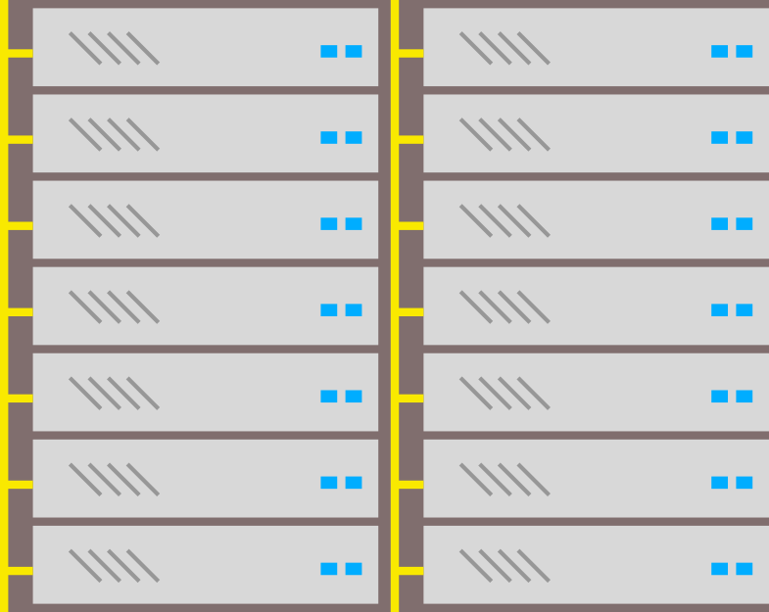
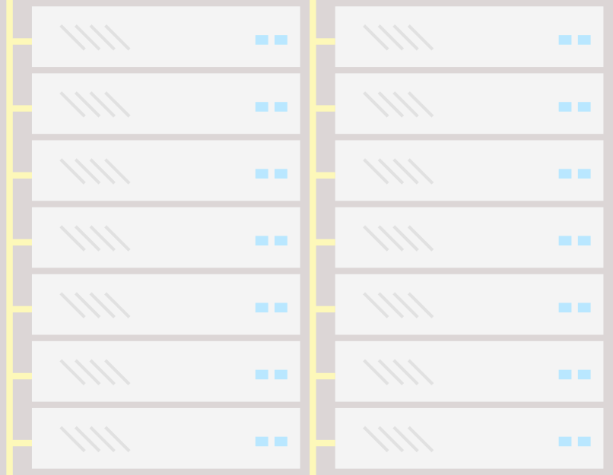

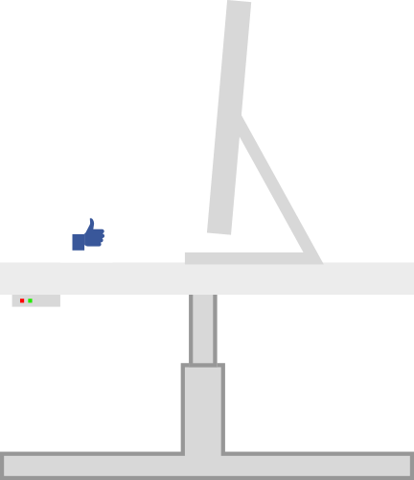

Howdy Docusaurus! 👋
Sayak Sarkar
Senior Software Engineer
Red Hat Inc.
@sayak_sarkar
https://sayak.in
*Image vectors sourced from: https://docusaurus.io
Notes:
Hey Everyone!
My name is Sayak Sarkar and I work as a Senior Software Engineer at Red Hat!
Professionally, I mostly dabble with Web & Cloud Technologies however, outside the professional realm, I’m an Open Source enthusiast and a privacy evangelist with an eye towards shiny new emerging tech in both the hardware and software world!

Slide 2
What would we cover during this session?
Origin
Features
Demo

Slide 3

Origins of Docusaurus...
*Image vectors sourced from: https://docusaurus.io

Slide 4
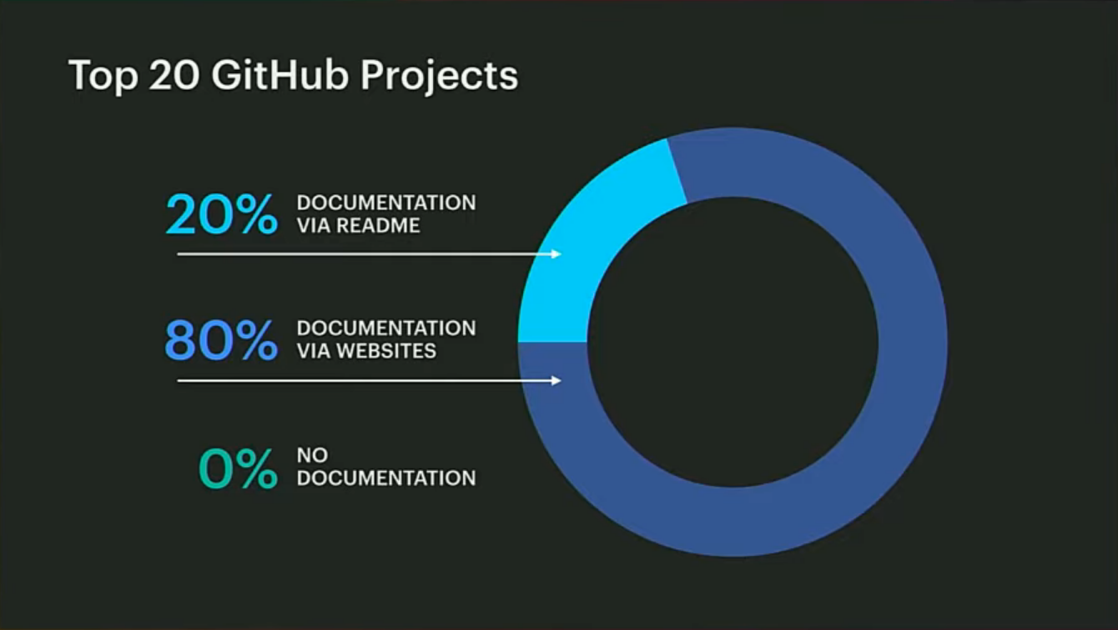
*Image vectors sourced from: https://www.youtube.com/watch?v=QcGJsf6mgZE
Notes:
A team of developers at Fb looked at the top 20 Github projects and found an interesting trend. 20% of these projects had documentation in the form of a README, while 80% of the projects have documentation using websites. None of them had no documentation, which means that all of them had documentation.
This proves how important documentation is. Even more importantly, it consolidates the notion that Documentation websites helps projects to provide a better user experience for their consumers.

Slide 5
Having a documentation website sounds great, so why don’t a lot of my favourite projects have them?
🤔
Notes:
Ok, so we all like websites and documentation websites are just the best! So why aren’t there documentation websites for more projects out there?
Well, it is because it is a lot of work! It can be quite laborious and time consuming a process.
You would need to have a set of artwork ready, then you would have to dabble with some html, css and javascript to get your components ready.
To top it all if you want to have a good documentation website then, you might also have to build a lot of features into it, document search, navigation, versioning, etc. More often than not project maintainers simply don’t have the bandwidth in terms of time and manpower to put into it. So documentation websites, tend to take backseat in terms of deliverables and priorities.
So, what’s solution then?

Slide 6

Docusaurus to the rescue!⛑️
*Image vectors sourced from: https://docusaurus.io
Notes:
Well, fear not! This is where we Docusaurus comes to our rescue!

Slide 7
So what is Docusaurus?
Docusaurus is a static site generator that helps you to develop websites quickly and easily.
Notes:
Docusaurus is a static site generator that helps you to develop websites quickly and easily. Even though there are already quite a few static site generators like Jekyll out there, you still need to build out quite a lot of documentation specific features for them, and even then there might be quite a lot of issues in scaling such sites when it comes to versioning and localization.

Slide 8





Features
Powered by Markdown
Built Using React
Localization Ready
Document Versioning
Document Search
*Image vectors sourced from: https://docusaurus.io
Notes:
Algolia is a search as a service provider
There’s a high chance that you have already used sites that are powered by Docusaurus. These include React Native, Babel, Create React and Prettier.

Slide 9
Demo time!! 🤞

Slide 10

Questions?
*Image vectors sourced from: https://www.freepik.com
Notes:
Any questions are welcome!

Slide 11

@sayak_sarkar
https://sayak.in
Thank you! :)
Notes:
Thank You! :)
You can find more about me on my webpage at https://sayak.in or contact me on twitter at @sayak_sarkar!

